Slide 1
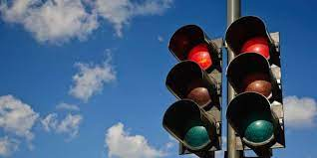
Traffic Light Signal Control using Deep Reinforcement Learning
Presented by-
Sayantika Mandal (1810110224)
Sanskar Tewatia (1810110215)
Under supervision of
Dr. Madan Gopal
(Professor, Electrical Department)

Slide 2
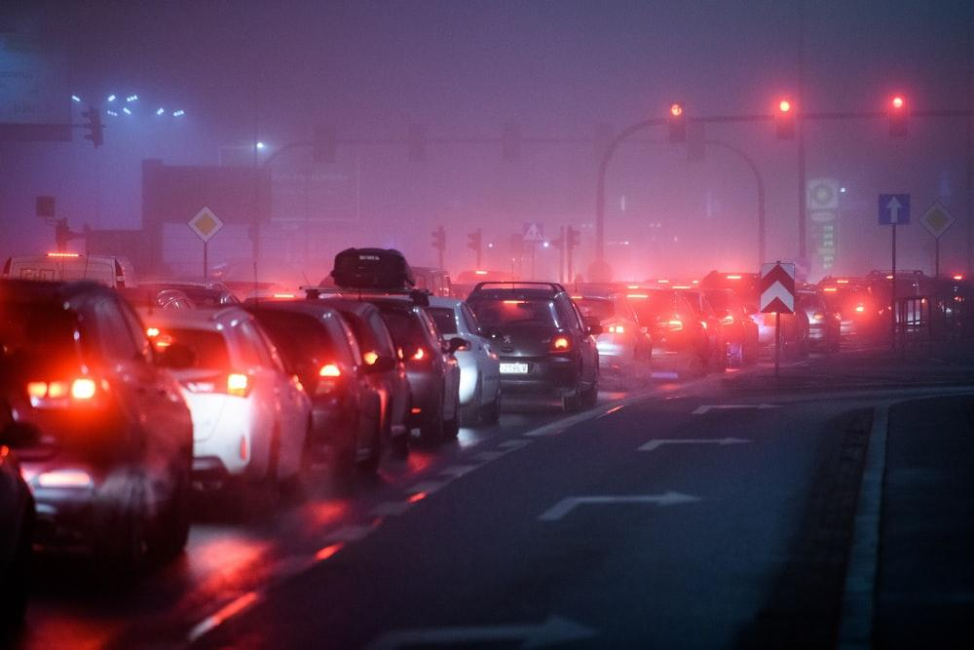
INTRODUCTION
At present, traffic signals are controlled by -
setting a fixed duration for each state of the traffic light,
using sensors under the road to estimate the signal duration.
Both methods - simple to implement, but unable to adapt to emergency, accidental or rush hour scenarios.
An adaptive traffic signal control(ATSC) technique would -
accurately process the current state of traffic
take optimal actions in regard to that state,
help decrease waiting time and queue length.
Deep Reinforcement Learning(DRL) - the most widely used technique to research about optimisation of traffic signals.
Notes:
Reinforcement Learning (RL), a feedback-based Machine Learning technique in which an agent observes a stochastic environment, perceives its state and learns automatically by exploring the environment and performing actions on a timely basis which results in a change in the environment to another state

Slide 3
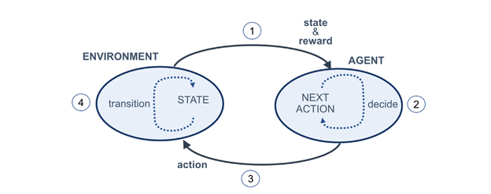
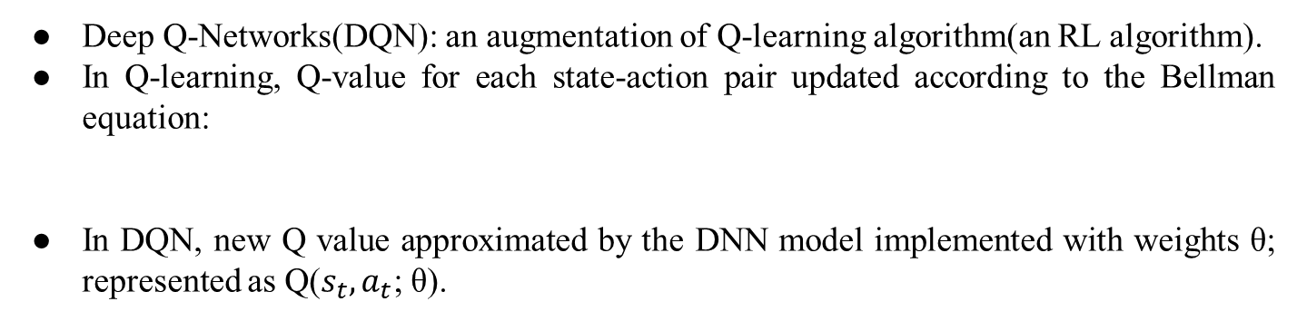
DRL
DRL : combination of RL and Deep Learning.
Agent: perceives the current state of the traffic simulator; chooses the optimal action (traffic light color) based on the exploitation of its learning experience.
Goal : maximize the reward.
Fig. 1: Reinforcement learning cycle
Deep Q-Networks(DQN): an augmentation of Q-learning algorithm(an RL algorithm).
In Q-learning, Q-value for each state-action pair updated according to the Bellman equation:
In DQN, new Q value approximated by the DNN model implemented with weights θ; represented as Q($s_{t},a_{t}$; θ).
Notes:
ENV – It is the representation of the problem
Agent – Is a computer program whose purpose is to take action on the decision
State – As the name suggests, it is the current state of the variables in the problem, like how many cars on which roads
Action – it is the decision taken by the agent
Reward – it is the feedback which is provided by the environment regarding the action taken by the agent
where Q(st,at) is the action a_{t} taken from state s_{t} at action step t or the current Q-value of state–action pair, Qnew is a new Q-value, α is learning rate, r_{t} is the reward associated to taking action a_{t} from state s_{t}, received from the environment, γ is discount factor (0 < γ < 1), maxQ is the estimate of optimal future value and a is any action from the possible action space. The term ( rt + gammaQ(st+1, a)) is known as the learned value.

Slide 4
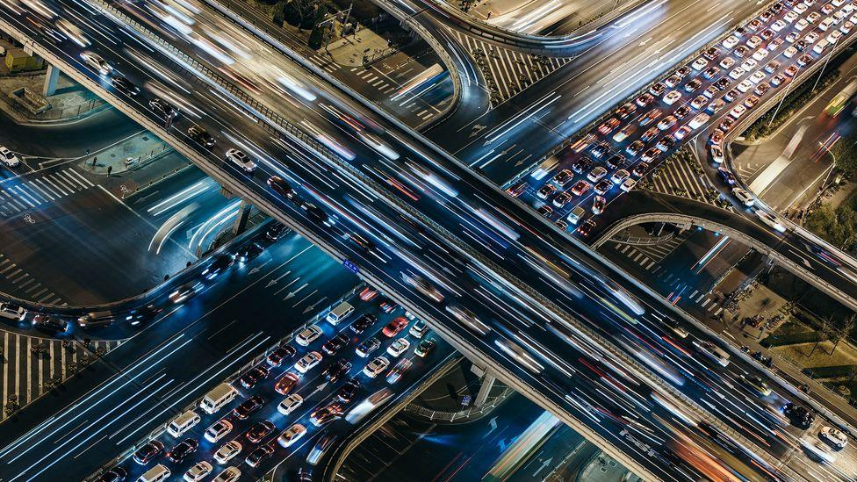
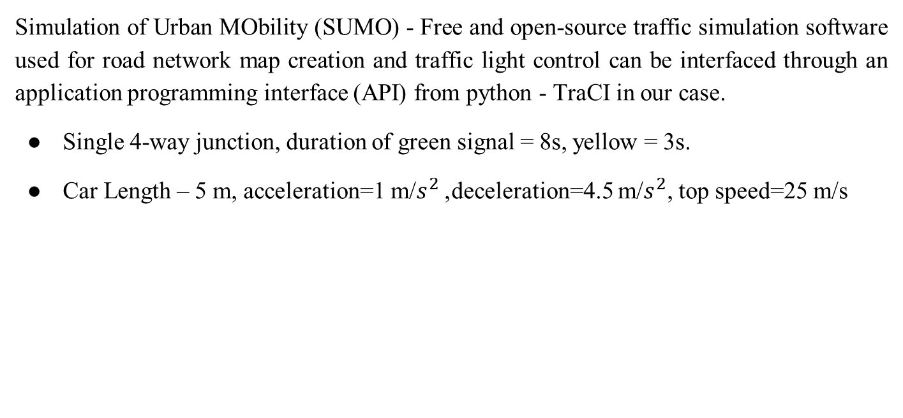
WORK DONE
Simulation of Urban MObility (SUMO) - Free and open-source traffic simulation software used for road network map creation and traffic light control can be interfaced through an application programming interface (API) from python - TraCI in our case.
Single 4-way junction, duration of green signal = 8s, yellow = 3s.
Car Length – 5 m, acceleration=1 m/$s^{2}$, deceleration=4.5 m/$s^{2}$, top speed=25 m/s
PRE – MIDSEM (baseline environment) | POST – MIDSEM (realistic environment)
2 Directions - EW and NS All cars going staright | 75% cars going staright and 25% free to take left or right turns
2 Lanes each of 750m | 4 Lanes each of 750m
1250 cars per episode of training | 1500 cars per episode of training

Slide 5
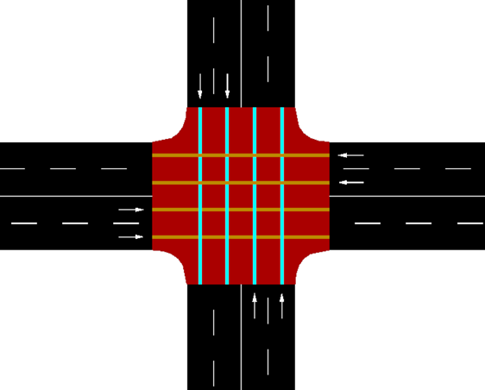
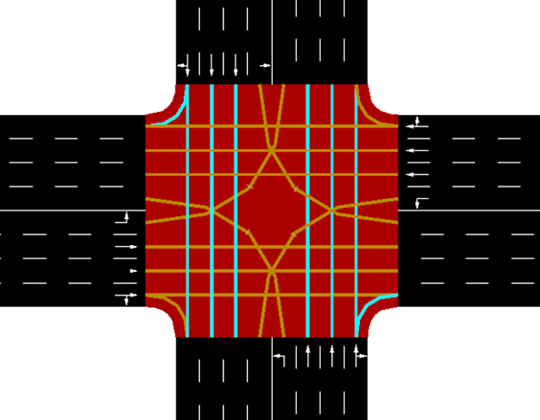
WORK DONE
Fig. 2: The SUMO environment junction representing 2 types of traffic
(baseline environment)
Fig. 3: The SUMO environment junction representing all types of traffic
(realistic environment)

Slide 6
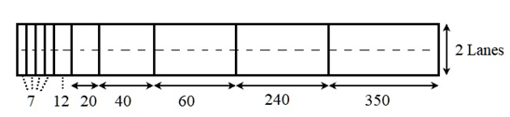
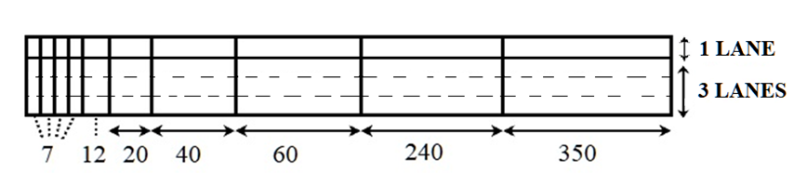
DRL APPROACH DESCRIPTION
STATE REPRESENTATION:
Spatial information of the vehicles inside the environment.
Each arm of the intersection - discretized into cells.
Cells not of same size:
the cell length increases as its distance from the intersection increases.
decreases the computational complexity.
Number of states = no. of cells in intersection:
In Fig. 4(a): 40 states
In Fig. 4(b): 80 states
(a)
(b)
Fig. 4 : State representation designs of the east arm of the intersection in
(a) baseline environment, (b) realistic environment

Slide 7
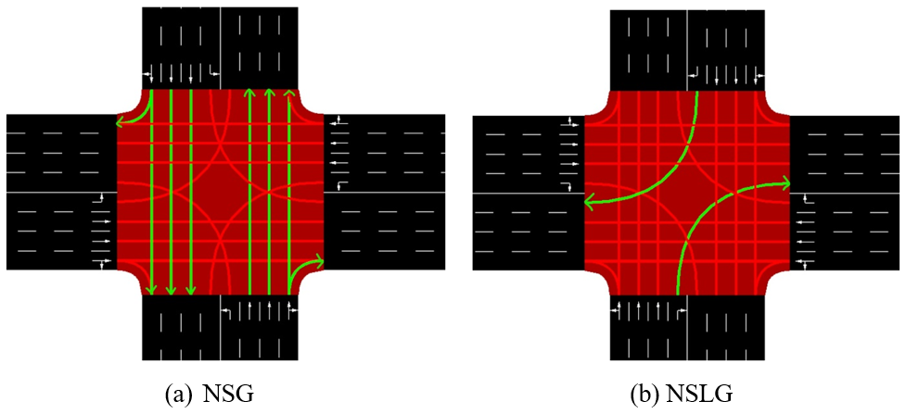
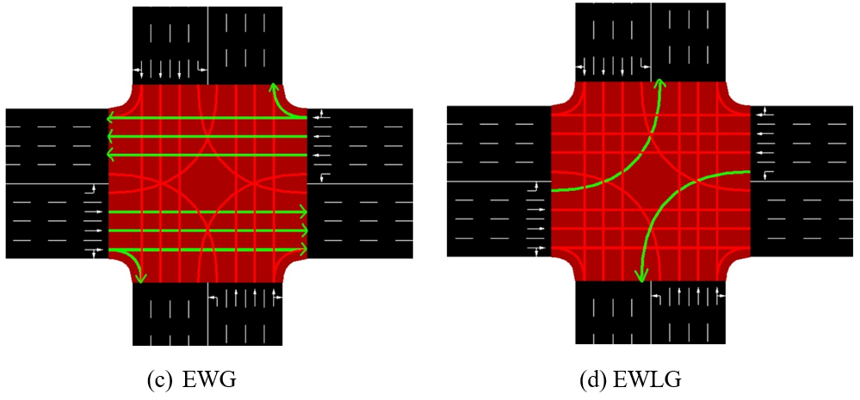
DRL APPROACH DESCRIPTION
ACTION SET:
Baseline environment: A={NSG,EWG}
Realistic environment: A={NSG,EWG,NSLG,EWLG}
If two different actions chosen at consecutive action steps ⇒ a yellow phase is introduced in between.
Fig. 5: Pictorial representation of possible actions

Slide 8
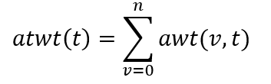
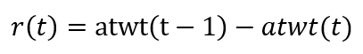
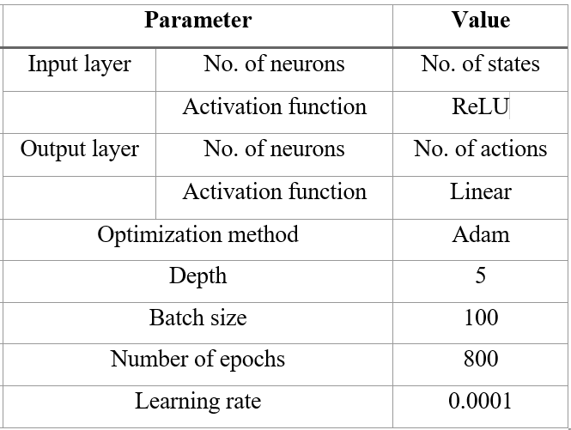
DRL APPROACH DESCRIPTION
REWARD FUNCTION:
Accumulated total waiting time(atwt) used as the metric.
where:
DEEP NEURAL NETWORK STRUCTURE:
Table 1: DNN model hyper-parameter details

Slide 9
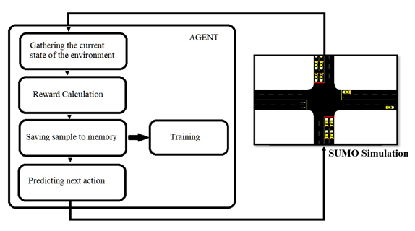
TRAINING PROCESS
Training done across 100-150 episodes(2 hours each).
1 simulation step = 1 second in SUMO ⇒ 7200 steps per episode.
Experience Replay technique adopted to improve the learning efficiency and performance of the agent.
To balance Exploration vs. Exploitation trade-off, ɛ-greedy exploration policy employed for action-selection.
Algorithm explores with a probability ɛ.
Agent exploits its learning experience with a probability 1- ɛ.
Fig. 6 : Agent’s workflow

Slide 10
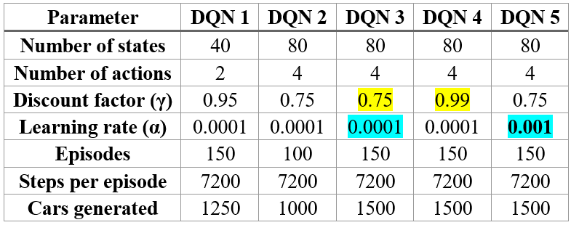
DQN AGENTS HYPER-PARAMETERS
Table 2: DQN Agent hyper-parameter details and training setting parameters

Slide 11
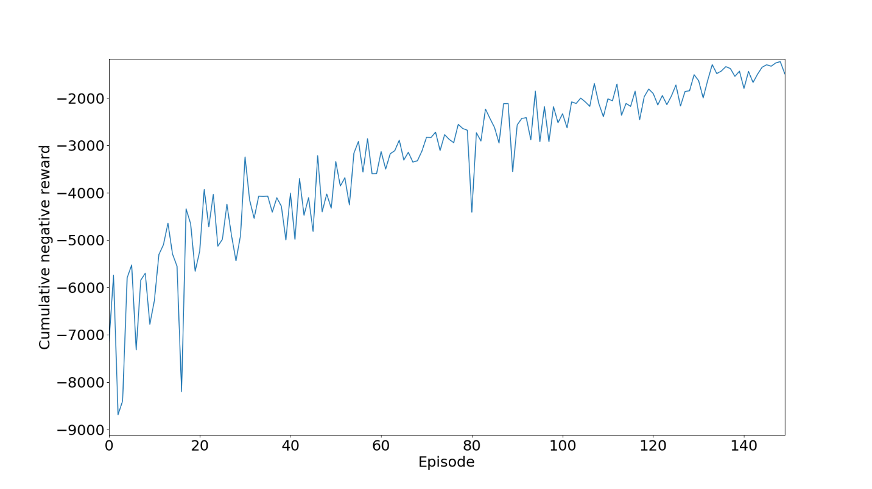
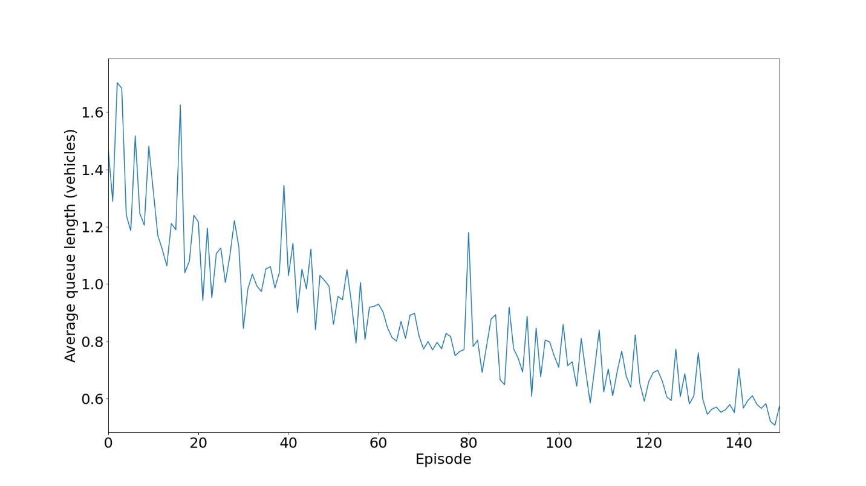
TRAINING PERFORMANCE
Fig. 8: Average queue length of vehicles per episode during training of DQN Agent 1
Fig. 7: Cumulative negative reward per episode during training of DQN Agent 1

Slide 12
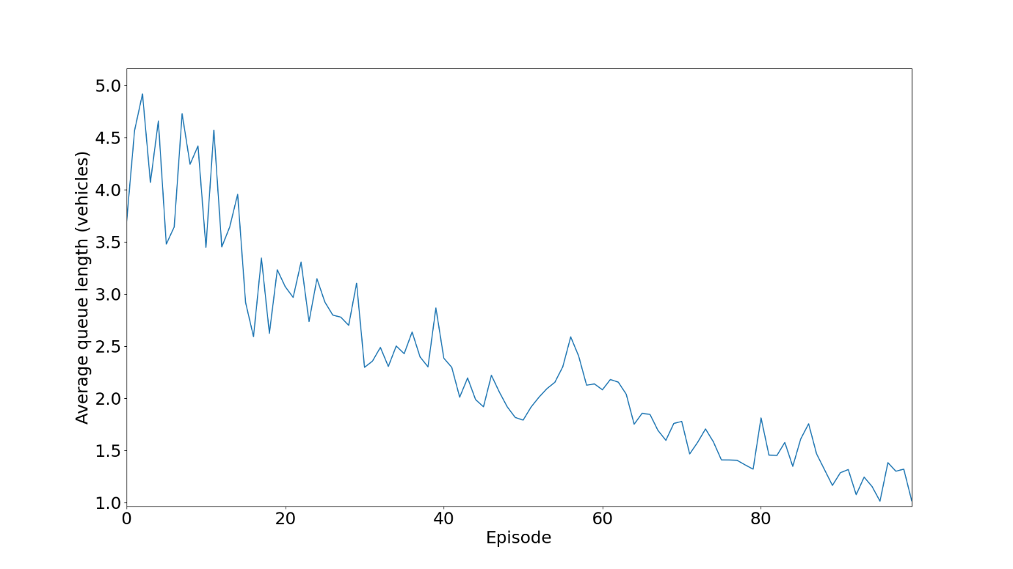
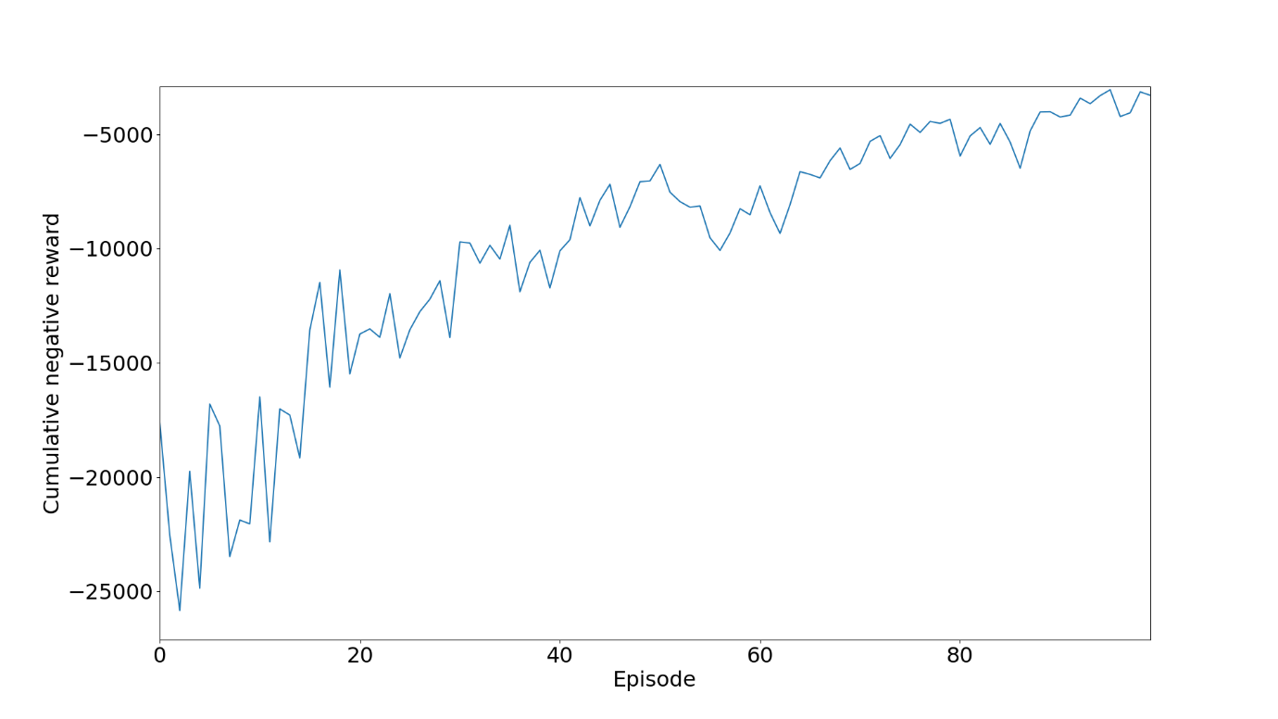
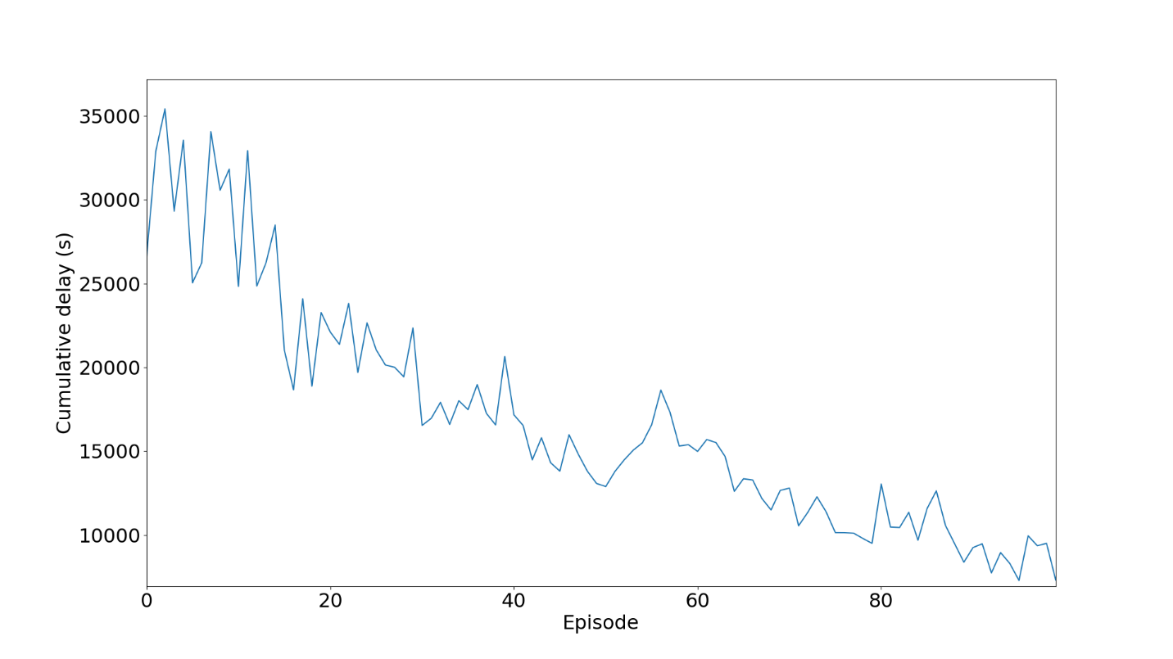
TRAINING PERFORMANCE
Fig. 10: Average queue length of vehicles per episode during training of DQN Agent 2
Fig. 9: Cumulative negative reward per episode during training of DQN Agent 2
Fig. 11: Cumulative delay of vehicles in seconds per episode during training of DQN Agent 2

Slide 13
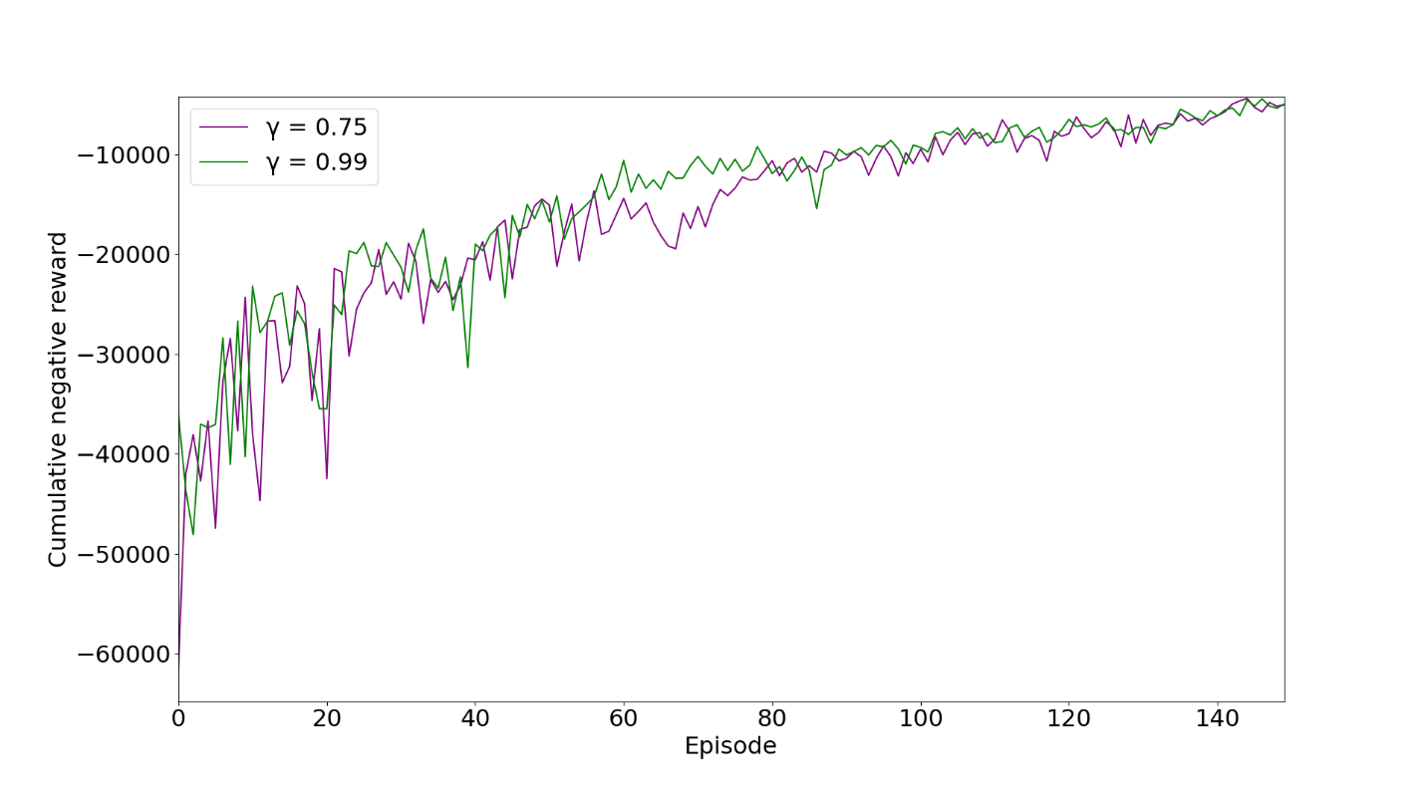
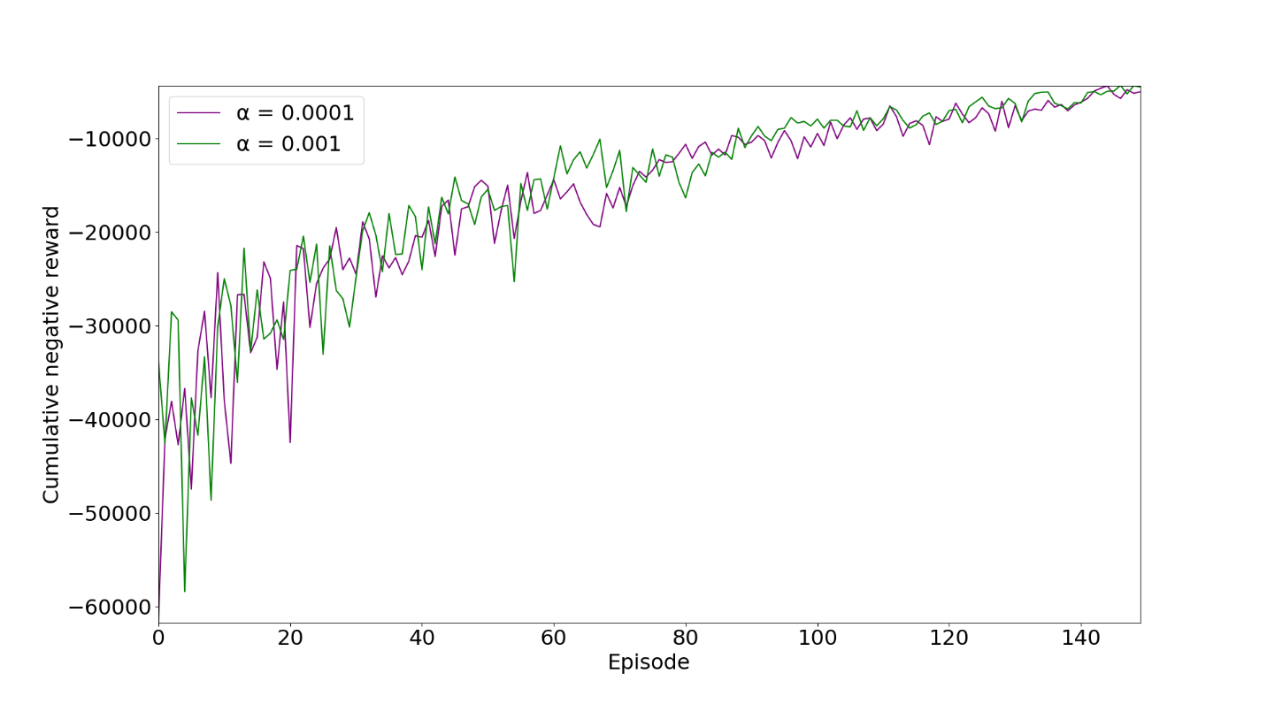
EFFECT OF HYPERPARAMETERS
Fig. 13: Cumulative negative reward of vehicles per episode during training for DQN Agents 3 and 5
Fig. 12: Cumulative negative reward of vehicles per episode during training for DQN Agents 3 and 4

Slide 14
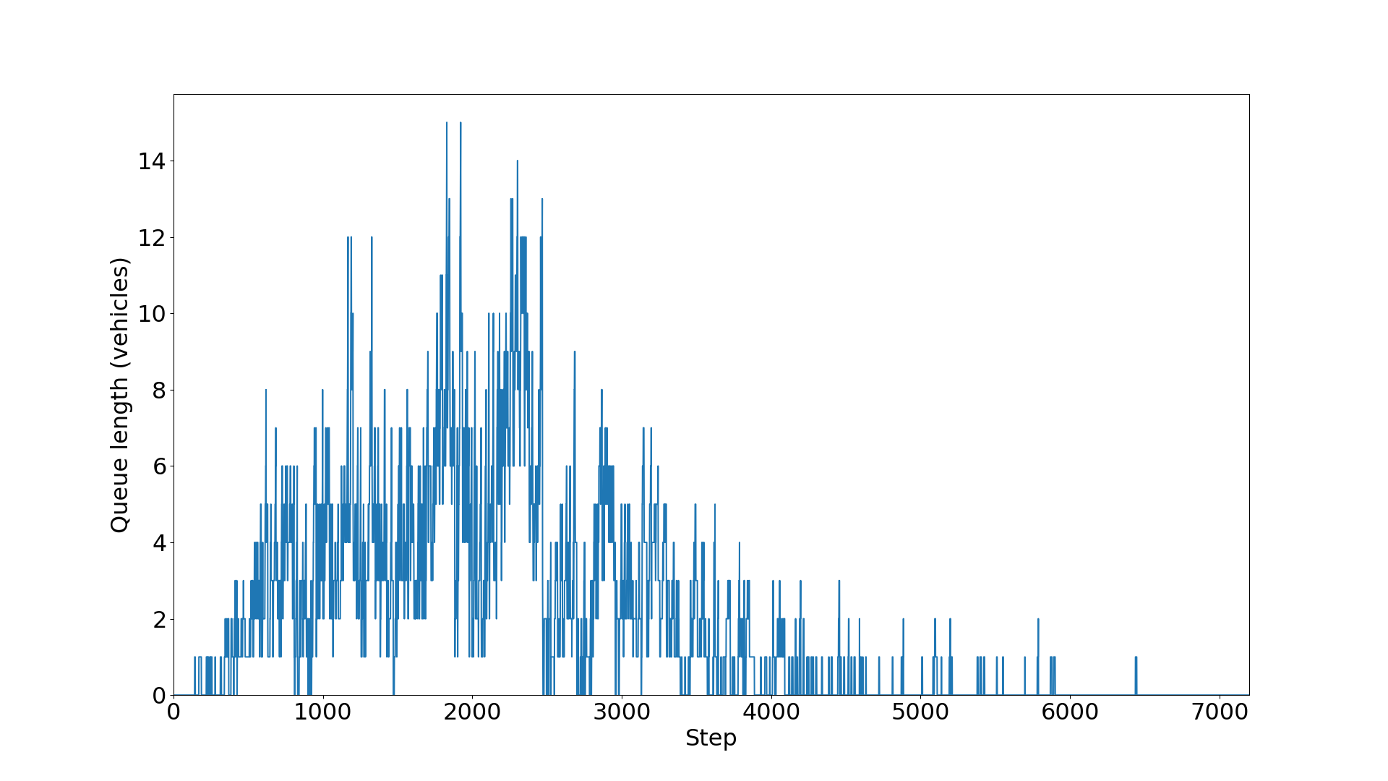
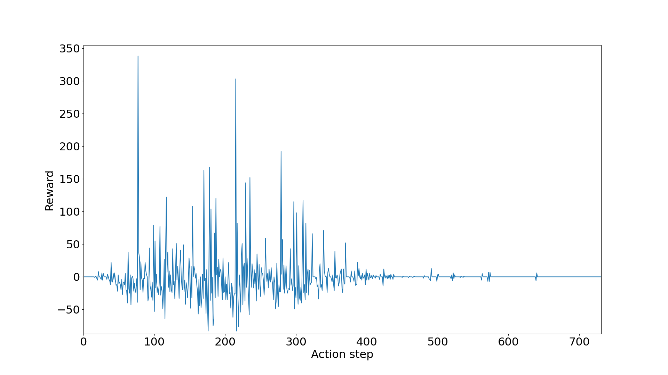
TESTING RESULTS (of best performing model)
Fig. 15: Reward of agent per action step during testing for DQN Agent 4
Fig. 14: Queue length of vehicles per simulation step during testing for DQN Agent 4

Slide 15
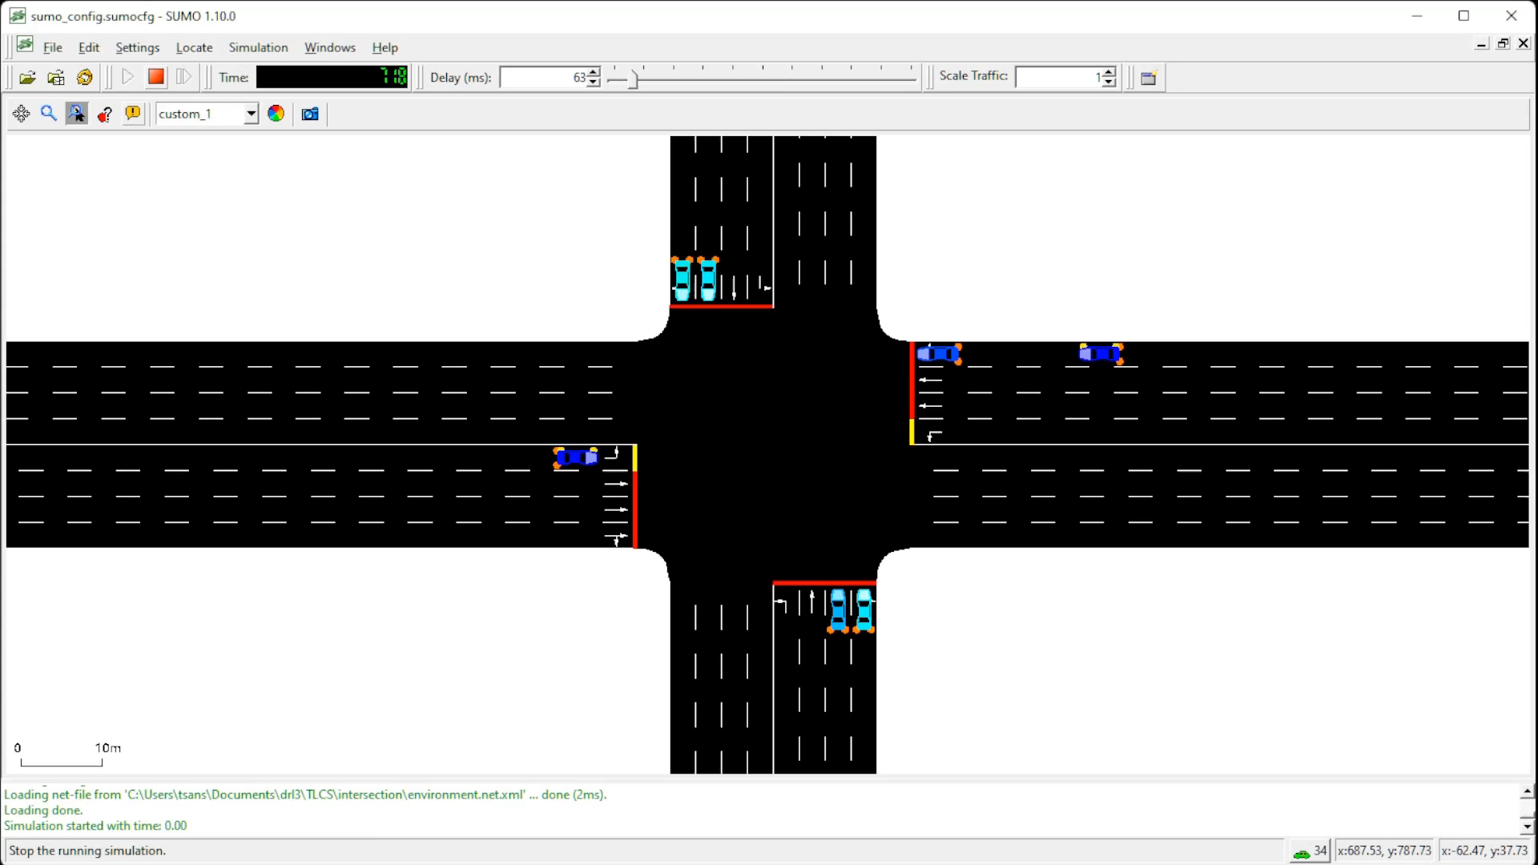
PRE-TIMED TRAFFIC SIGNAL CONTROL SIMULATION

Slide 16
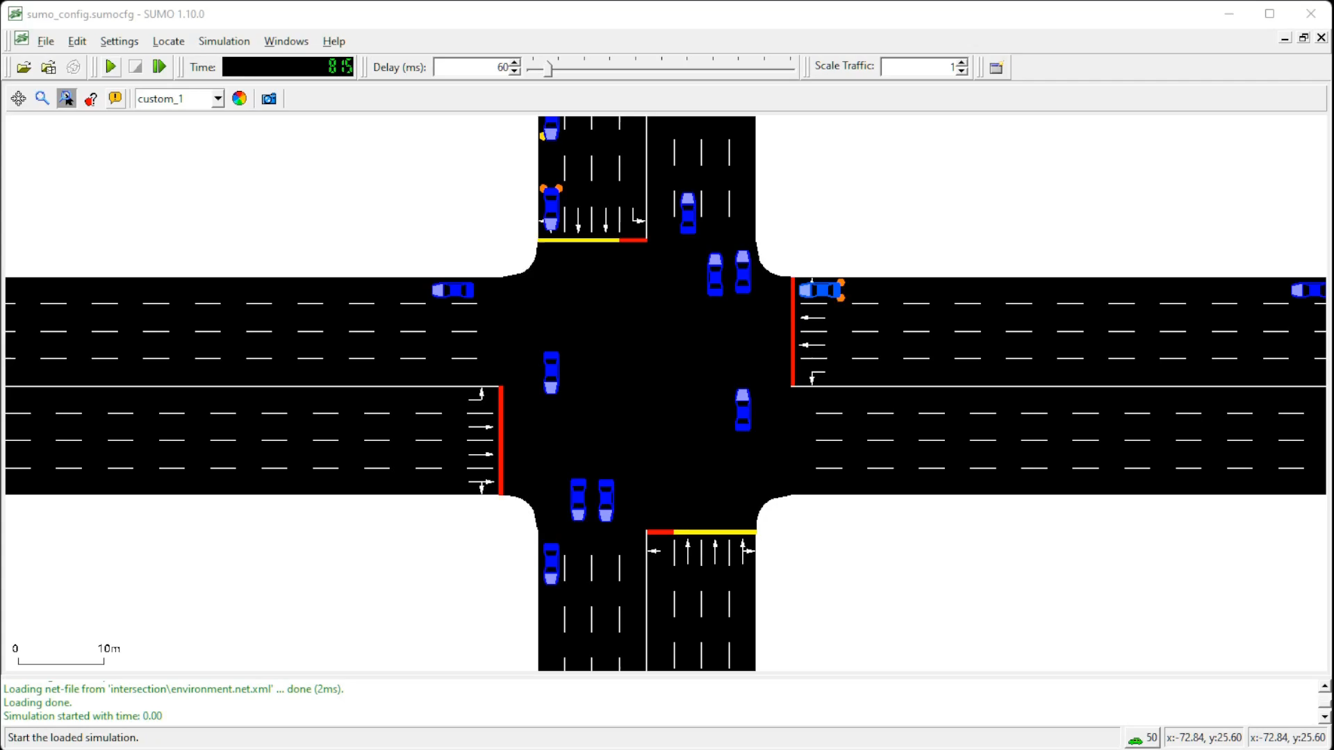
DRL AGENT BASED ATSC - TESTING SIMULATION

Slide 17
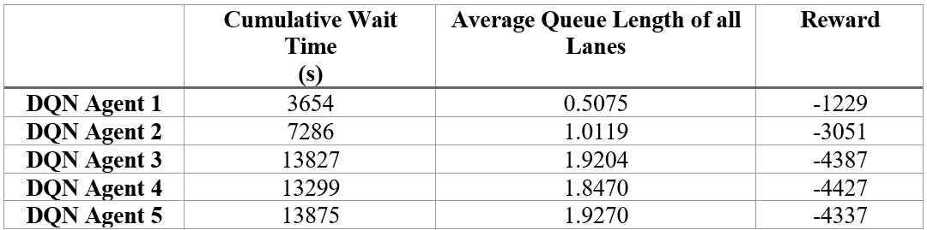
RESULTS & CONCLUSION
Table 3: Performance of Agents w.r.t Delay, Queue Length and Reward
Table 3 lists the final values obtained from training of the various DQN models.
All the DRL agents were able to learn a stable policy and can perform better than the traditional pre-timed circuits.

Slide 18
REFERENCES
H. Wei et al, “IntelliLight: A Reinforcement Learning Approach for Intelligent Traffic Light Control,” Proceedings of the 24th ACM SIGKDD International Conference on Knowledge Discovery & Data Mining, pp. 2496–2505, July 2018.
Alan J Miller., “Settings for fixed-cycle traffic signals.”, Journal of the Operational Research Society 14, vol. 4, pp. 373–386, 1963.
Lior Kuyer, Shimon Whiteson, Bram Bakker, and Nikos Vlassis, “Multiagent reinforcement learning for urban traffic control using coordination graphs,” Machine learning and knowledge discovery in databases, pp. 656–671, 2008.
Wiering, M., “Multi-agent reinforcement learning for traffic light control,” In Machine Learning: Proceedings of the Seventeenth International Conference (ICML’2000), pp. 1151–1158, 2000.
Sajad Mousavi, S., Schukat, M. and Howley, E., “Traffic Light Control Using Deep Policy-Gradient and Value-Function Based Reinforcement Learning,” arXiv e-prints, pp. arXiv-1704, 2017.
Martin et al., “Application of Deep Reinforcement Learning in Traffic Signal Control: An Overview and Impact of Open Traffic Data”, Journal of Applied Sciences, vol. 10, issue 4011, 2020.
Liang, X., Du, X., Wang, G. and Han, Z., “Deep reinforcement learning for traffic light control in vehicular networks,” arXiv preprint, arXiv:1803.11115, 2018.
Williams, R. J., “Simple statistical gradient following algorithms for connectionist reinforcement learning”. Machine learning, vol. 8, issue 3-4, pp. 229–256, 1992.
Chin, Y.K.; Kow, W.Y.; Khong, W.L.; Tan, M.K.; Teo, K.T.K., “Q-Learning Traffic Signal Optimization within Multiple Intersections Traffic Network,” In Proceedings of the 2012 Sixth UKSim/AMSS European Symposium on Computer Modeling and Simulation, Valetta, Malta, pp. 343–348, November 2012.
Li, D., Wu, J., Xu, M., Wang, Z., Hu, K., “Adaptive Traffic Signal Control Model on Intersections Based on Deep Reinforcement Learning,” J. Adv. Transp. 2020.
K. Tan et al, “Deep Reinforcement Learning for Adaptive Traffic Signal Control,” Proceedings of the ASME 2019, Dynamic Systems and Control Conference DSCC2019, November 2019.
A. Vidali, L. Crociani, G. Vizzari, and S. Bandini, “A deep reinforcement learning approach to adaptive traffic lights management,” in Proc. Workshop ‘From Objects Agents’, pp. 42–50, 2019.
L. Li, Y. Lv, and F.-Y. Wang, “Traffic signal timing via deep reinforcement learning,” IEEE/CAA Journal of Automatica Sinica, vol. 3, issue 3, pp. 247–254, 2016.
W. Genders and S. Razavi, “Using a deep reinforcement learning agent for traffic signal control,” arXiv preprint arXiv:1611.01142, 2016.
Mengqi Liu, Jiachuan Deng, Ming Xu, Xianbo Zhang, and Wei Wang, “Cooperative Deep Reinforcement Learning for Traffic Signal Control.”, 2017.
Gao, J., Shen, Y., Liu, J., Ito, M., and Shiratori, N., “Adaptive traffic signal control: Deep reinforcement learn learning algorithm with experience replay and target network,”. arXiv preprint arXiv:1705.02755, 2017.

